Slide 1
Stock Price Prediction
Team 8 – Aditi, Shweta, Roshan

Slide 2
The steps involved in predicting stock price of Amazon , Facebook and Google has been conducted in the following way
Second Step
Fourth Step
Feature engineering and Model Generation
Insights Generation and next steps
First Step
Data Extraction
and Text mining
Third Step
Model validation
and fine tuning
Web scraping of Yahoo and Twitter data
Data pre-processing
Sentiment Analysis
Transform and adding new indicators
Build forecast models like ARIMA and UCM
Develop machine learning models
Error analysis and validation of model
Ensembling the models to boost accuracy
Use models to present the right method to forecast sales price
Give directionality to user

Slide 3
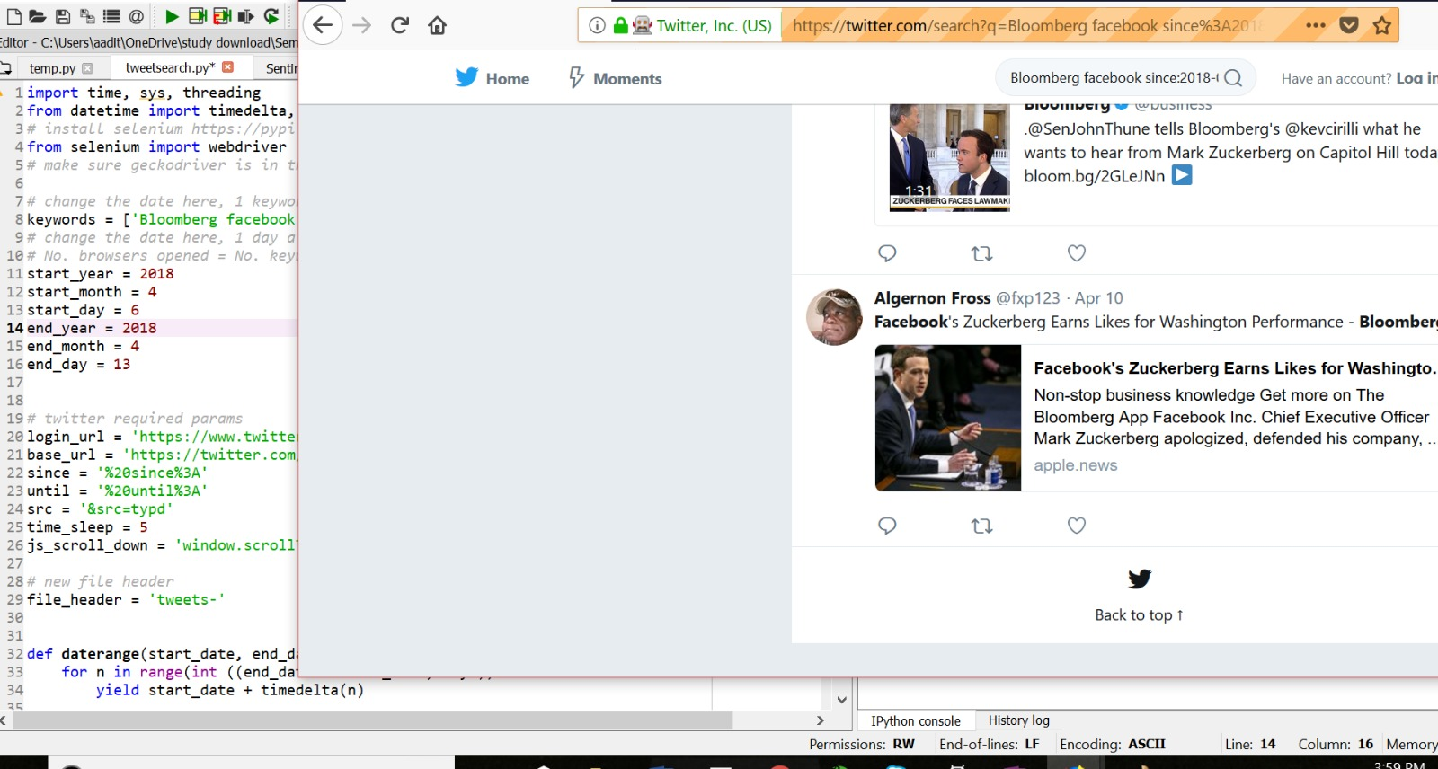
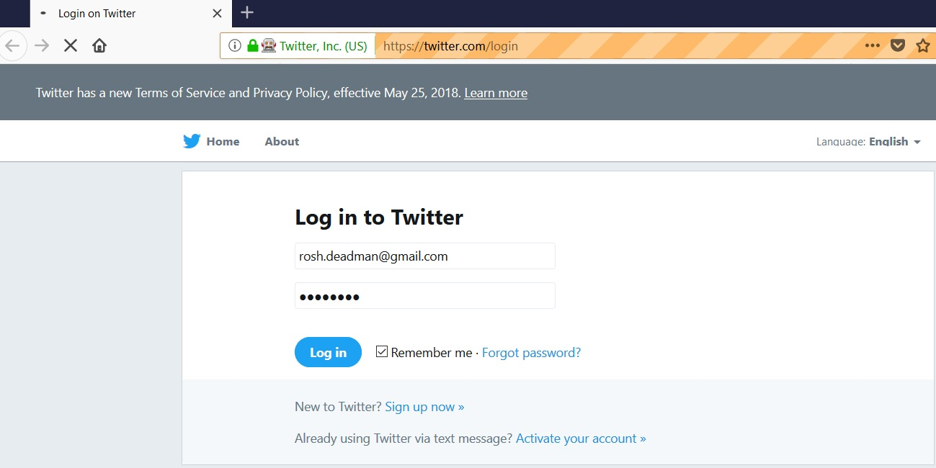
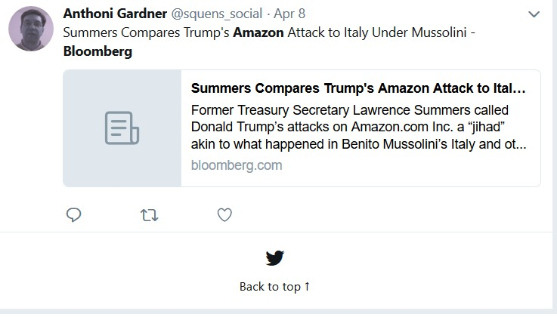
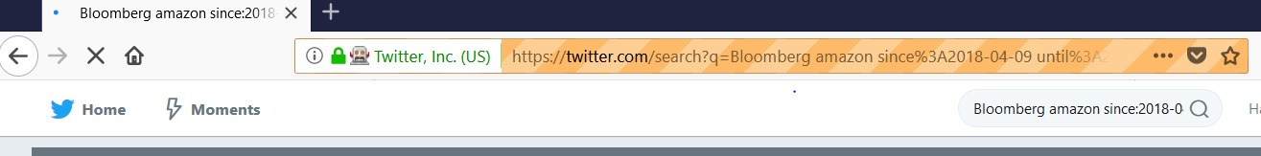
Twitter data was extracted using a Python shell script for all the stocks going back to a time period of 4 months
1
2
3
4

Slide 4
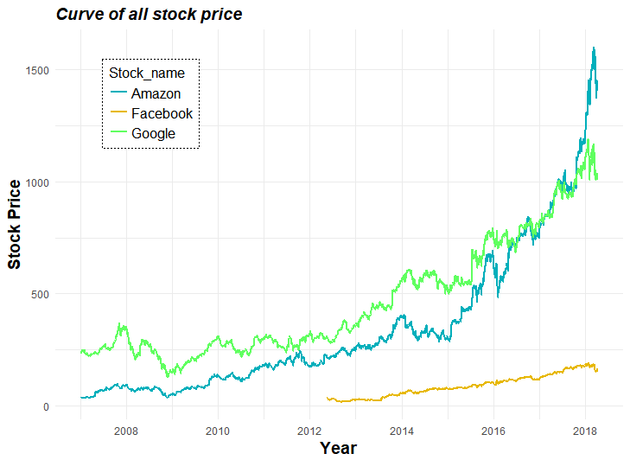
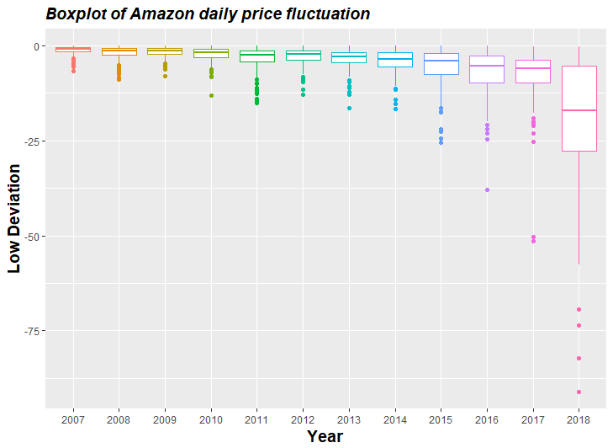
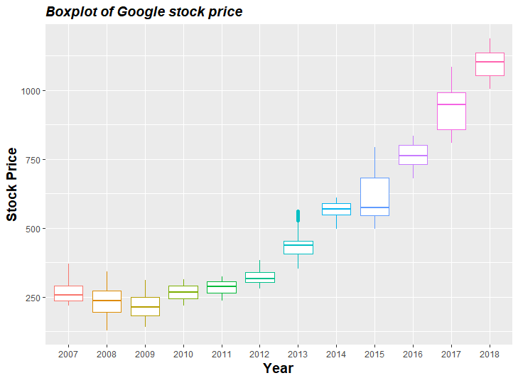
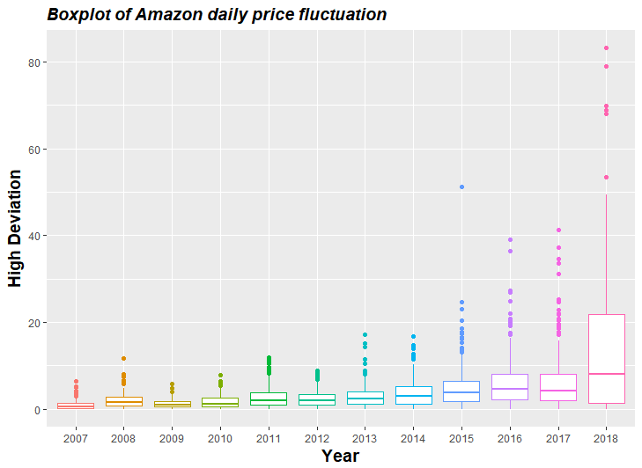
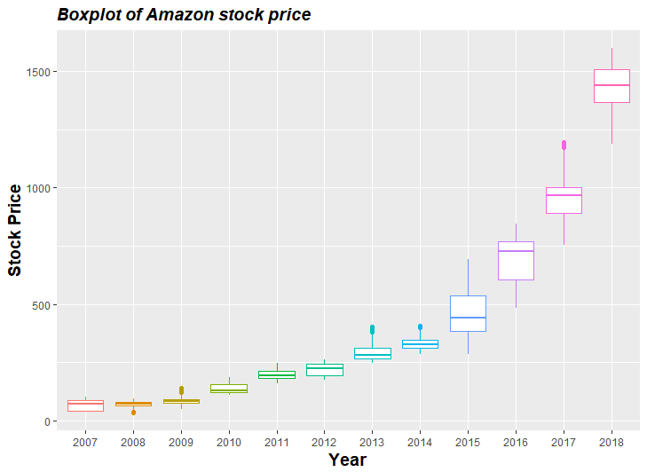
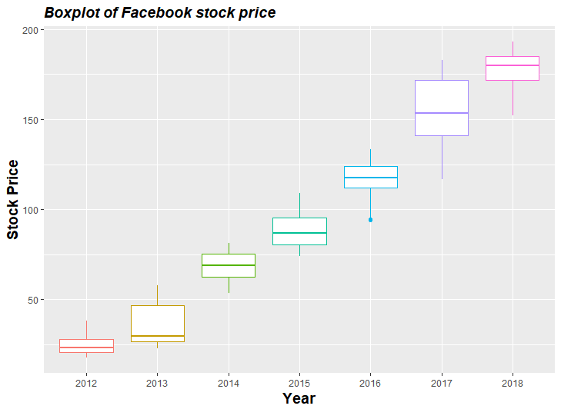
Exploratory data analysis was conducted to come up with high level insights about the behavior of stocks over time

Slide 5
To predict stock price with trend and sentiment analysis we have to take certain scenarios into consideration
Problem
We do not carry the tweets for the future, therefore forecasting stock prices with tweets is not possible
Assumption
Date | Open price | High Price | Low Price | Close Price | Volume | pos_tweet | neg_tweet | Tweet_lag
1/16/2018 | 1273.39 | 1305.76 | 1273.39 | 1305.2 | 5443700 | 92% | 8%
1/17/2018 | 1323 | 1339.94 | 1292.3 | 1304.86 | 7220700 | 83% | 17% | 8%
Solution
Predict with lag of tweet – Memory = 1 . Forecast for next day
Predict univariate timeseries. Forecast for the next 30 days

Slide 6
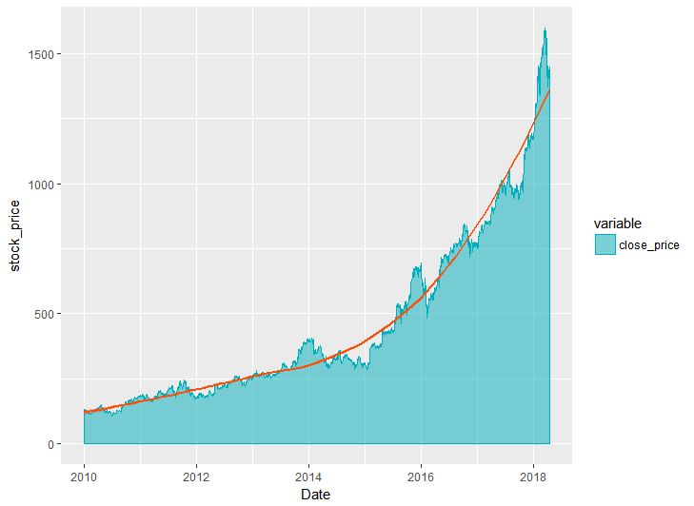


Before getting into the modelling aspect, there are some considerations that went behind the process
Modelling conditions
Model has around 2083 points in last 7 years.
Highly fluctuating and nonstationary
To avoid generalization we build model on 3 months data and validate on 1 month
Modelling variables
Trend
Lag 1
Lag 2
Lag 3
Lag 4
Lag 5
Other vars
Stock vol
Stock high
Stock low
Friday
Monday
Seasonality
Jan
Feb
March
Event
Positive tweet
Negative Tweet
$$≅$$
Stock price

Slide 7

Amazon stock price forecasting - A quick summary on all modelling results for both cases
Model | Timeframe | Level | Forecast ahead | MAPE | RMSE
ARIMA | 3 Months | Daily | 1 month | 96% | 139
NN |  |  |  | 95% | 181
UCM |  |  |  | 92% | 163
LSTM |  |  |  | 83% | 212
Holt winters |  |  |  | 74% | 251
Stock Price Forecasting
Model | Timeframe | Level | Forecast ahead | External Variable | Direction Accuracy
ARIMAX | 3 Months | Daily | 1 Day | Negetive tweet | 61%
NN |  |  |  |  | 72%
UCM |  |  |  |  | 66%
GBM |  |  |  |  | 53%
SVM |  |  |  |  | 41%
Stock Price Prediction

Slide 8
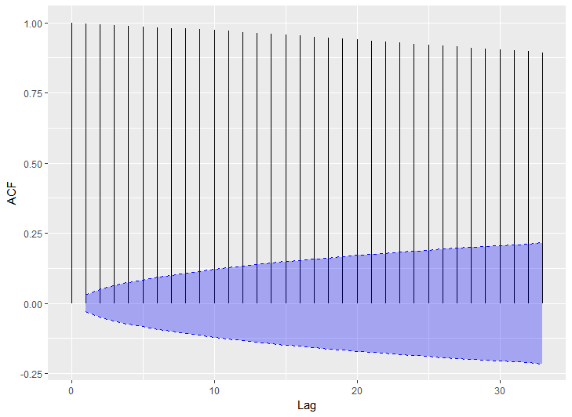
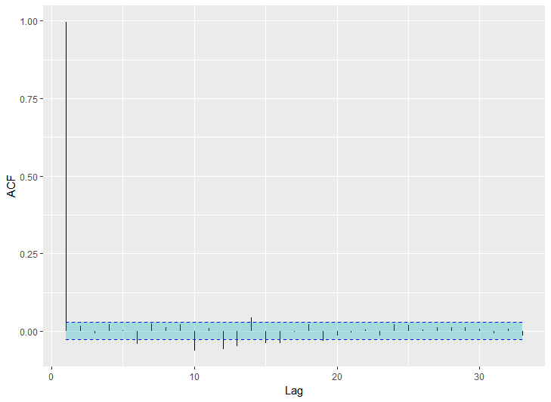
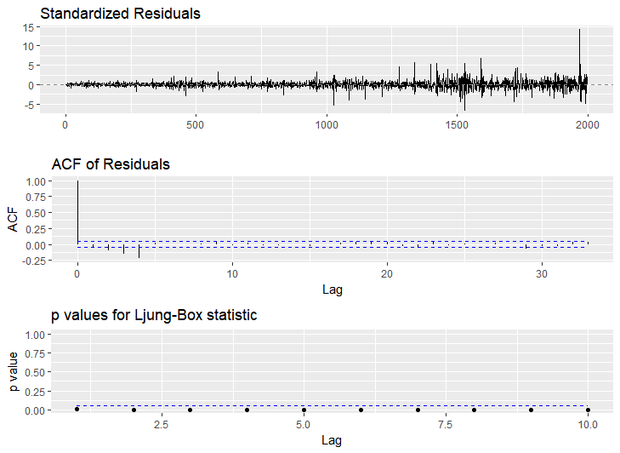
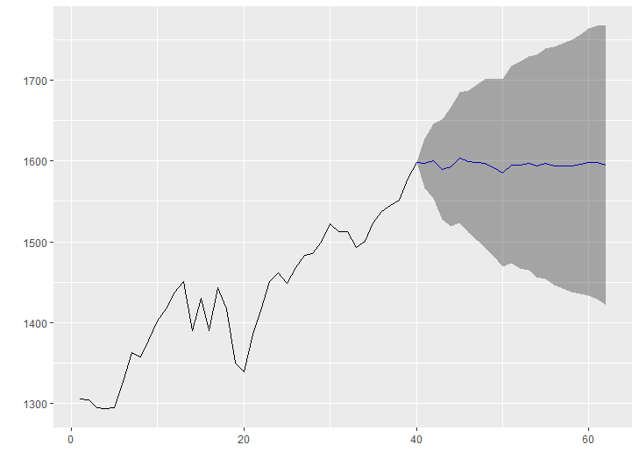
The Arima Model was built using the Auto Arima condition since the ACF and PACF plot did not show any clear indication of (P,D,Q)
ACF Plot
PACF Plot
Residual Statistics
Model Equation
 | ARIMA (2,1,2) |  |  |  |  |  | Sigma^2 | 536.4
 | Series: Amazon stock |  |  |  |  |  | AIC | 370.91
 | ar1 | ar2 | ma1 | ma2 | Neg tweet |  | RMSE | 129.3
Coefficients: | 0.08 | -0.73 | 0.06 | 1.00 | -33.34 |  | MAPE | 6.75%
SE | 0.21 | 0.15 | 0.14 | 0.12 | 16.20 |  | MAE | 105.2
Forecast Plot

Slide 9
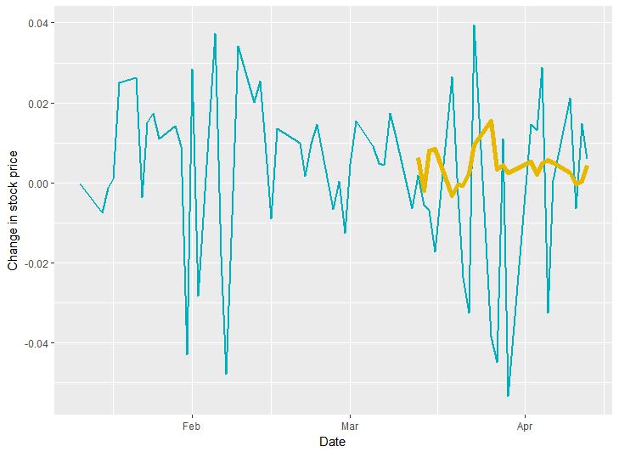
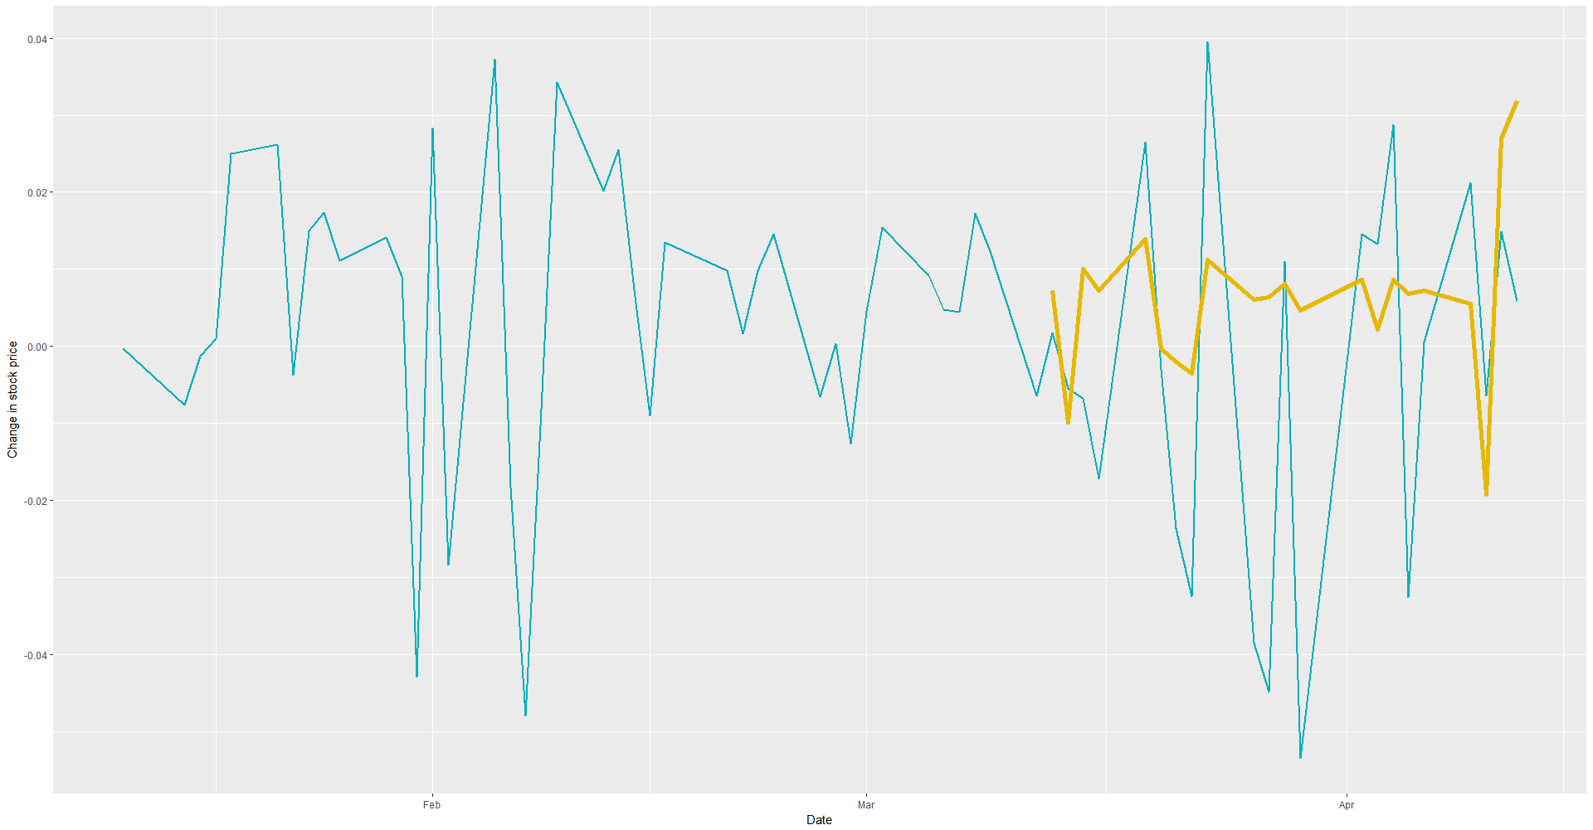
Time Series Forecasting for directionality is done with machine learning models that can better model the trend and has a good memory
Unobserved Component Model
Neural Network Model
A trend ,slope and irregular component model is considered for this exercise
Average of 20 networks, each of which is a 2-4-1 network with 17 weight with linear output units
 | Actual State | Predicted State | # correct
Week 1 |  |  | 3
Week 2 |  |  | 3
Week 3 |  |  | 4
Week 4 |  |  | 4
 | Actual State | Predicted State | # correct
Week 1 |  |  | 4
Week 2 |  |  | 3
Week 3 |  |  | 4
Week 4 |  |  | 4
Accuracy | 64%
Decision | Increase
Accuracy | 72%
Decision | Increase

Slide 10
We run the entire activity for the other two stocks and come out with a model for predicting price and forecasting the trend
Time Series Forecasting
Time Series Regression
Stock | Model | Timeframe | Level | MAPE | Model
AMAZON | ARIMA | 3 Months | Daily | 96% | Arima
 | NN |  |  | 93%
 | UCM |  |  | 92%
FB | ARIMA | 3 Months | Daily | 84% | Arima
 | NN |  |  | 88%
 | UCM |  |  | 89%
GOOGLE | ARIMA | 3 Months | Daily | 86% | Arima
 | NN |  |  | 90%
 | UCM |  |  | 92%
Stock | Model | Timeframe | Level | Accuracy | Model
AMAZON | ARIMA | 3 Months | Daily | 63% | NN
 | NN |  |  | 72%
 | UCM |  |  | 66%
FB | ARIMA | 3 Months | Daily | 53% | NN
 | NN |  |  | 59%
 | UCM |  |  | 55%
GOOGLE | ARIMA | 3 Months | Daily | 48% | UCM
 | NN |  |  | 55%
 | UCM |  |  | 59%

Slide 11



Recommendations – The predicted value and direction of the stocks are as follows
2 points
3 points
5 points

Slide 12
Thank You

